Slide 1

Law and Legal Institutions
LAWS8586

Slide 2
Session 1

Slide 3
What is Law?
Law is:
• Set of rules made by a person or body recognised as having the authority to make rules that are binding on those to whom they apply and which can be enforced by the institutions of the government as a last resort (Heilbron et al [103]).

Slide 4
What is the Purpose of Law?
Regulate human behaviour.
‘Man’s life is nasty, brutish and short’ Hobbes (17th C)
Rule of Law
‘…most of the content of the rule of law can be summed up in two points: that the people (including, one should add, the government) should be ruled by the law and obey it and that the law should be such that people will be able (and, one should add, willing) to be guided by it.’
– Geoffrey de Q. Walker, The rule of law: foundation of constitutional democracy, (1st Ed., 1988).

Slide 5
rule of law principles
The separation of powers between the legislature, the executive and the judiciary.
The law is made by representatives of the people in an open and transparent way.
The law and its administration is subject to open and free criticism by the people, who may assemble without fear.
The law is applied equally and fairly, so that no one is above the law.
The law is capable of being known to everyone, so that everyone can comply.
No one is subject to any action by any government agency other than in accordance with the law and the model litigant rules, no one is subject to any torture.
The judicial system is independent, impartial, open and transparent and provides a fair and prompt trial.
All people are presumed to be innocent until proven otherwise and are entitled to remain silent and are not required to incriminate themselves.
No one can be prosecuted, civilly or criminally, for any offence not known to the law when committed.
No one is subject adversely to a retrospective change of the law.

Slide 6
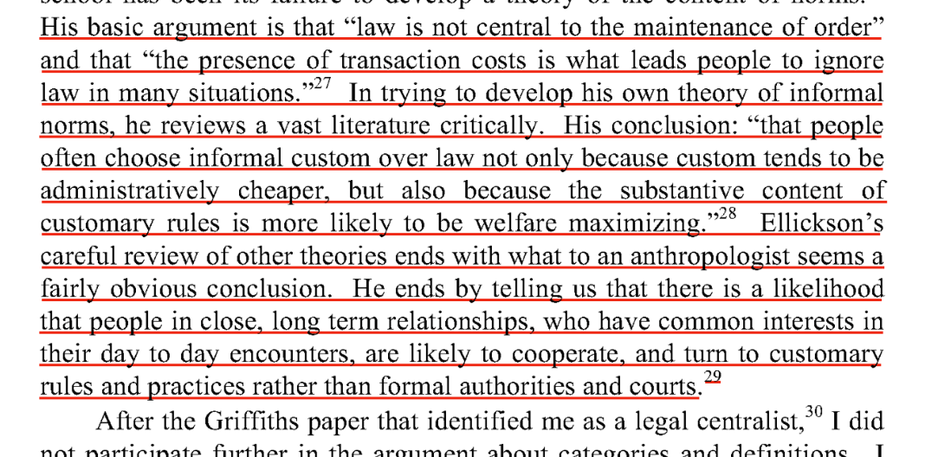
What is the purpose of law?
Law as a means of resolving disputes:

Slide 7
Purpose of Law
Law as coercive and controlling

Slide 8
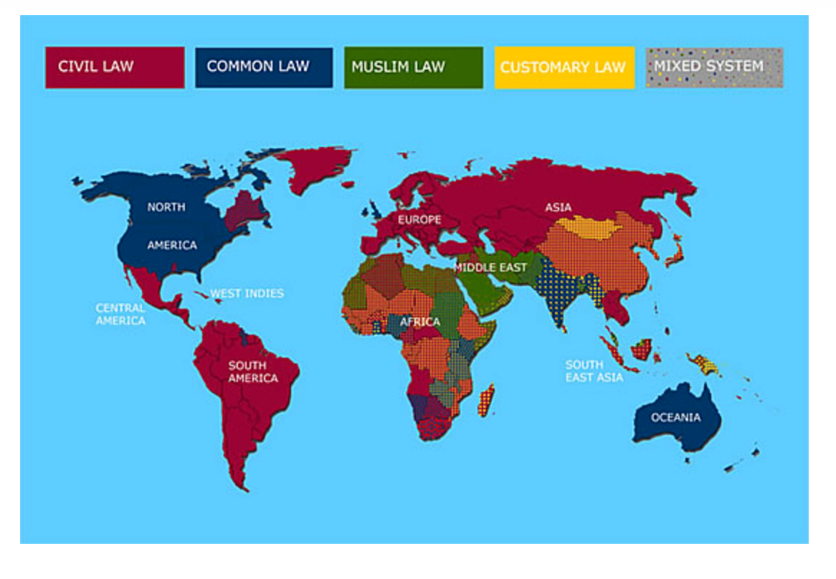
Systems of Law

Slide 9
Common law
judicial decisions as the basis of common law and legislative decisions as the basis of civil law.
Common law has no comprehensive compilation of legal rules and statutes – largely based on precedent.
Common law functions as an adversarial system, a contest between two opposing parties before a judge who moderates.
.

Slide 10
Civil law
Civil Law is codified – continuous update of legal codes.
Codes distinguish between different categories of law:
- substantive law establishes which acts are subject to criminal or civil prosecution.
- procedural law establishes how to determine whether a particular action constitutes a criminal act, and
- penal law establishes the appropriate penalty.

Slide 11
Customary Law
The hundreds of Australian indigenous communities, nations and societies each have their own territories, languages, myths, and laws. Relations between the communities are governed by highly organised, uncodified systems. Customary laws govern, for example, marriage and family, distribution of property, dispute settlement and criminal justice. See more in The Definition of Aboriginal Customary Laws (ALRC, Recognition of Aboriginal Customary Law, Report No 31, 1986)

Slide 12
Mabo v Queensland (No 2) ((1992) 175 CLR 1
The High Court rejected the notion of terra nullius and recognised a preexisting indigenous system of law.
The Native Title Act 1993 (Cth) was subsequently enacted to give effect to the Mabo decision, and to set out processes for claiming native title

Slide 13
Customary law
A Reconsideration of Basic Questions. On 9 February 1977, the then Federal Attorney-General, Mr RJ Ellicott QC, referred to the Commission the question:
whether it would be desirable to apply either in whole or in part Aboriginal customary law to Aborigines, either generally or, in particular areas, or to those living in tribal conditions only (Report 31 of the ALRC)

Slide 14
Recognition of Customary Law
I would submit, therefore, that it is necessary from the moment the Aborigines of this Country are declared British Subjects they should, as far as possible, be taught that the British Laws are to supersede their own, so that any native, who is suffering under their own customs, may have the power of an appeal to those of Great Britain, or, to put this in its true light, that all authorized persons should in all instances be required to protect a native from the violence of his fellows, even though they be in the execution of their own laws.^{[4]}
Report by Grey on the Method for Promoting the Civilization of Aborigines, Enclosure in correspondence, Lord John Russell to Sir George Gipps, 8 October 1840, HRA ser 1, vol 21, 35.

Slide 15
Milirrpum v Nabalco Pty Ltd (1971) 17 FLR 141 ( The Gove Land Rights case)
Claim by the Yolngu people (Arnhem Land, Gove Peninsula, NT) in the Supreme Court of the NT. In response to bauxite mining on their traditional lands, The Yolngu sought a declaration that they were entitled to the occupation and enjoyment of their land without interference.
1) From Headnote: on what (factual) basis did the plaintiffs claim they held ‘communal native title’ over the land?
2) P 14 (Westlaw version) – what did Blackburn J say about the plaintiffs’ social organisation?
3) P 60 – did Blackburn J find that the plaintiffs had a system of law? How did he describe that system?
4) P 62 Why did Blackburn J find that the plaintiffs held no ‘proprietary interest’ in the land? [ ie no property interest as understood by the common law

Slide 16
Session 2

Slide 17
Doctrine of precedent
Common law is made by judges in a court, using precedent – decisions made in previous similar cases – to decide how they will judge a case before them. If no past cases with similar circumstances exist, a new decision is made, which would then become a precedent for a future similar case. If no statute law applies to cover a particular situation, common law will apply; however, statute law always overrides common law.

Slide 18
Statute law
‘Statute law
Statute law is made by parliament. In the Australian Parliament, a bill is a proposal for a new law or a change to an existing one. A bill becomes a law after it has been passed in the same form by the House of Representatives and the Senate and is given Royal Assent by the Governor-General. It is then called an Act of Parliament.

Slide 19
Human Rights (Parliamentary Scrutiny) Act 2011:s.7
a. to examine Bills for Acts, and legislative instruments, that come before either House of the Parliament for compatibility with human rights, and to report to both Houses of the Parliament on that issue;
b. to examine Acts for compatibility with human rights, and to report to both Houses of the Parliament on that issue;
c. to inquire into any matter relating to human rights which is referred to it by the Attorney-General, and to report to both Houses of the Parliament on that matter.

Slide 20
Delegated Legislation
Parliament gives the power to make decisions about the details of laws it makes to the relevant minister, executive office-holder or government department. This is called delegated law because the power has been delegated

Slide 21
Terminology
stare decisis – to stand by things decided.
doctrine of precedent under which a court is bound to follow previous decisions, unless they are inconsistent with a higher court's decision or wrong in law’.
The principle of a case is sometimes referred to as the ratio decidendi (the reasoning for the decision).
binding authority (i.e. the court must follow the principle of the previous decision unless that decision can be distinguished as having been decided on different facts).
Persuasive authority - Where courts are not bound by previous decisions but still look to those decisions for guidance.

Slide 22
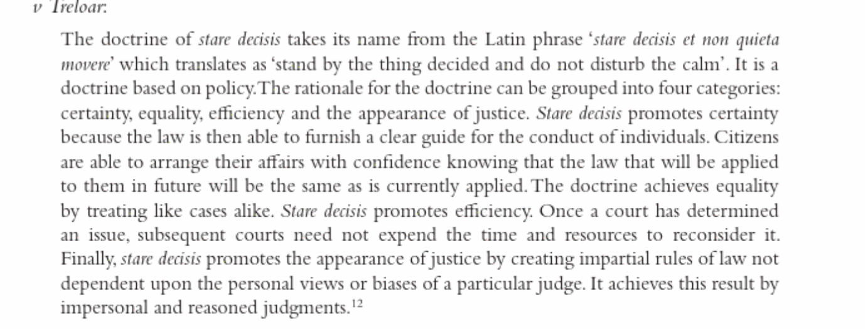
Telstra corporation v Treloar [2000] FCA 1170; 102 FCR 595

Slide 23
Doctrine of precedent
Each court is bound by decisions of courts higher in its hierarchy
A decision of a court in a different hierarchy or lower in the same hierarchy may be ‘persuasive’ but not binding
Generally a court will not consider itself bound by its own past decisions but will depart from them only with reluctance - and this includes the High Court
Only the ratio decidendi (‘reason for the decision’) of a past case is binding
Obiter dicta (‘remarks in passing’) are not binding but may be persuasive
Precedents do not lose their force by lapse of time
Case law may be overridden by legislation

Slide 24
Family circuit court and federal circuit court of Australia
The government’s reforms have:
established a single point of entry for federal family law matters
established a single set of court rules, forms, practices, and procedures
strengthened judicial appointment criteria
streamlined the family law appeals pathway.

Slide 25
Federal court of australia
•Administrative and Constitutional Law and Human Rights NPA
Admiralty and Maritime NPA
Commercial and Corporations NPA
Commercial and Corporations NPA sub-areas:
Commercial Contracts, Banking, Finance and Insurance
Corporations and Corporate Insolvency
General and Personal Insolvency
Economic Regulator, Competition and Access
Regulator and Consumer Protection
International Commercial Arbitration
Federal Crime and Related Proceedings NPA
Employment and Industrial Relations NPA
Intellectual Property NPA
Intellectual Property NPA sub-areas:
Patents and associated Statutes
Trade Marks
Copyright and Industrial Designs
• Native Title NPA
• Taxation NPA

Slide 26
Court hierarchy - ACT
ACT Magistrates Court
This is the lowest court in the hierarchy and it is where all criminal prosecutions begin.
The kind of cases that a magistrate court might deal with are:
Less serious matters, carrying a maximum penalty of not more than two years’ imprisonment, must be dealt with in the Magistrates Court.

Slide 27
Court hierarchy - act
The ACT Supreme Court
This where the most serious matters will be decided.
If an offence carries a maximum penalty of more than 10 years, it must be dealt with in the Supreme Court

Slide 28
Court hierarchy- act
ACT Court Of Appeal
The ACT Court of Appeal was established in 2001 3 judges sit in the hearing and consider the single judgement of the supreme court –
To be granted an appeal the party must convince the Court that the Judge that heard the original case made an error of law and that the error was of such significance that the decision should be overturned.

Slide 29
State hierarchy
STATE HIERARCHY:
Local Courts (incl Magistrates Court / Small Claims / Coroners Court / Court of Petty Sessions / Children’s Court) >>> District / County Courts >>>> State Supreme Court – Single Judge (Courts / tribunals of civil & specialist jurisdiction) >>> State Supreme Court – Court of Appeal / Full Court >>> High Court of Australia

Slide 30
High court
Sir Owen Dixon said on his swearing in as Chief Justice of Australia:
"The High Court's jurisdiction is divided in its exercise between constitutional and federal cases which loom so largely in the public eye, and the great body of litigation between man and man, or even man and government, which has nothing to do with the Constitution, and which is the principal preoccupation of the court."

Slide 31
Judgments - reported
raise significant points of law
introduce a new principle of law
significantly modify an existing principle of law
settle a question of law
apply an established principle in a new area
define or interpret legislation or legal terms, or is particularly instructive

Slide 32
Case citation
parties’ names (ie, the people in dispute)
date (NB depending on whether there are square brackets or round brackets, the year may or may not be the year in which the case was handed down)
(for some reports) a volume number
abbreviation of the law report
page number where case starts
Mabo v Queensland [No 2] (1992) 175 CLR 1

Slide 33
ratio
Ratio / rationes:
‘the reason(s) for deciding’ – the legal principle(s) in relation to the facts of the case which the court has relied on in coming to its decision.
Obiter dictum / dicta
a ‘passing remark’

Slide 34
Session 3

Slide 35
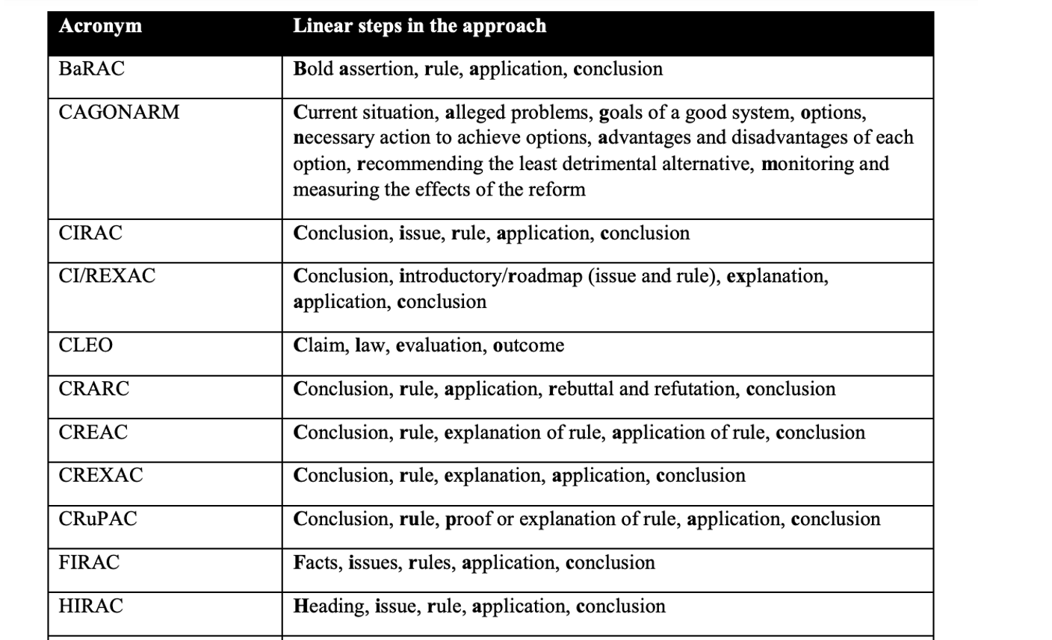
Approaches to analysing problem questions

Slide 36
hirac
H (give a heading – usually the heading will be a statement of the issue)
I (state the issue)
R (state the relevant legal rule, giving ‘authority’)
A (apply the law (rule) to the facts); and
C (reach a conclusion on that issue)

